Slide 1
ASL(American Sign Language) Detection Using Convolutional Neural Networks
Presented By: Deep Dand
Assisted By: Shruti Kulkarni
Under Guidance of: Dr.Pablo Rivas

Slide 2
Concept:
American sign language is method of communicating among the speech and hearing impaired community.
The project goal is to create American sign language detection model using Convolutional neural network.

Slide 3
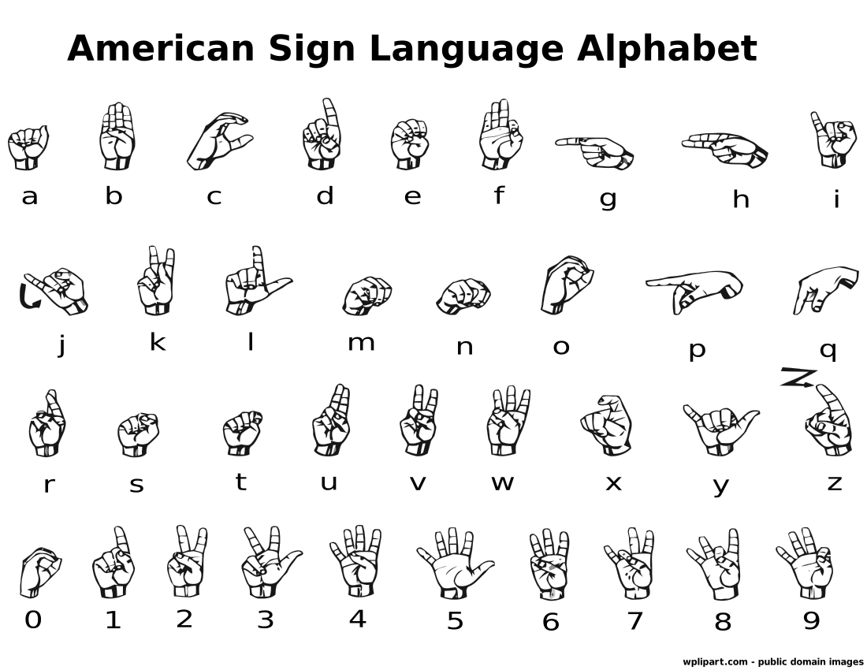
What is American Sign Language(ASL)?
The sign language has same signs for “V” and “2”, “W” and “6”, “O” and “0”.
Also “j” and “z” need hand gestures.
Because of these reasons we are not including 5 classes and have 31 classes instead of 36 classes.

Slide 4
Existing Systems:
Author | Algorithm | Process | Result
Nachanau. M | SIFT | Preprocessing the Color images - 16x16 size | 100% accuracy in test data
Brandon Garcia and Sigberto Alarcon Viesca | SVM | Utilized pretrained GoogLeNet architecture and resized images to 256x256 | Letters a-y = 72% accuracy Letters a-k = 74% accuracy Letters a-e = 97% accuracy

Slide 5
About the Data:
We use a dataset of segmented images captured with a depth-sensor camera for different subjects [1].
We have data of five different subjects(From S01-S05).
Each subject has 6,200 images .
Images are divided into 31 different classes (From C01-C31).
Currently, images of subject S01, S02, S03 are used for training and subject S04 and S05 are used for testing.

Slide 6
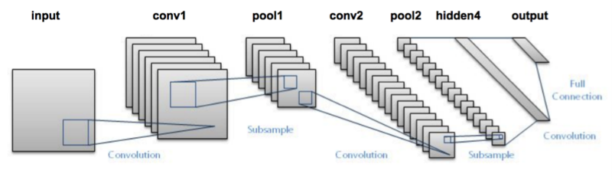
CNN Architecture:

Slide 7
CNN Architecture:
Number of Layers - 2
Layer 1
32 filters
Relu activation
Maxpool filter size- 1
Layer 2
64 Filters
Relu activation
Maxpool filter size- 2
Fully Connected Layer -
512-1024 units.
Softmax activation
Dropout layer - configured to drop results less than 0.8
Number of Classes - 31
IMG_SIZE = 256x256
Learning rate - 1e3

Slide 8
Results:
Filter |  | Maxpool filter |  | Units in Fully Connected layer | Epochs | Test Accuracy | Val Accuracy
L1 | L2 | L1 | L2
3 | 3 | 1 | 2 | 512 | 5 | 0.04 | 0.03
5 | 5 | 1 | 1 | 512 | 3 | NA | NA
5 | 5 | 1 | 1 | 756 | 3 | NA | NA
5 | 5 | 1 | 2 | 512 | 3 | 0.03 | 0.03
5 | 5 | 1 | 2 | 512 | 5 | 0.03 | 0.03
3 | 3 | 3 | 3 | 1024 | 5 | 0.03 | 0.03
3 | 5 | 3 | 5 | 1024 | 5 | 0.037 | 0.032
5 | 3 | 5 | 3 | 1024 | 5 | 0.098 | 0.095
5 | 5 | 5 | 5 | 1024 | 5 | 0.9 | 0.9
Next experiments

Slide 9
Future Enhancements:
Since the images we are dealing with are 256x256, adding more convnet layers will improve feature extraction and result in the better accuracy of the model.
Also, once the experiments complete with existing config, the next config will have more epochs with architecture that gives best result with 5 epochs.

Slide 10
Acknowledgments
References
I would like to thank Dr Pablo for the guidance in this project and Shruti for assisting in the research for CNN architecture.
[1] Byeongkeun Kang, Subarna Tripathi, and Truong Q Nguyen. Real-time sign language fingerspelling recognition using convolutional neural networks from depth map. In Pattern Recognition (ACPR), 2015 3rd IAPR Asian Conference on, pages 136–140. IEEE, 2015.

Slide 11
Questions?

Slide 12
Thank You!

